Slide 1
Relational Database Management System
By: Florence Dube-Olajide
19 October 2024

Slide 2
Objective
Explain the differences between relational and non-relational databases.
Provide a clear and concise explanation of their characteristics, use cases, and advantages.
Understand the key factors to consider when choosing a database for a specific application.

Slide 3
What is a Data Base
A database is an organized collection of structured and unstructured information, or data, typically stored electronically in a computer system.
A database is usually controlled by a database management system (DBMS).

Slide 4
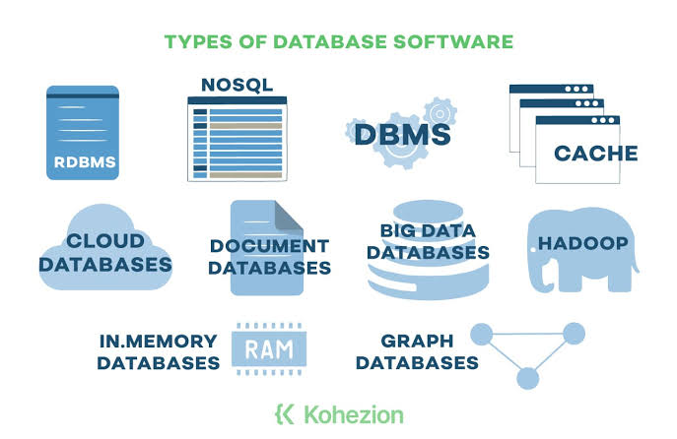

Slide 5
What is a Relational Data Base
Definition: A database that stores data in a structured format, using tables, rows, and columns.
Characteristics:
Data normalization
ACID properties (Atomicity, Consistency, Isolation, Durability)
SQL (Structured Query Language)
Examples: MySQL, PostgreSQL, Oracle, SQL Server

Slide 6
What is Non-Relational Data Base
Definition: A database that stores data in a flexible format, using key-value pairs, documents, or graphs.
Characteristics:
No fixed schema
BASE properties (Basically Available, Soft state, Eventually consistent)
NoSQL (Not Only SQL)
Examples: MongoDB, Cassandra, Redis, Neo4j

Slide 7
What is the Difference Between Relational & Non-Relational Data Base
Relational Data Base
Use a structured format to store data in tables with rows and columns. Each table represents a different entity, and relationships between tables are defined through foreign keys.
Non-Relational Data Base
NoSQL databases, store data in a variety of formats (e.g., key-value pairs, documents, graphs) and are more flexible with schema design.

Slide 8
Advantages of Relational & Non-Relational Database
Advantages of Relational Databases
Data integrity and consistency
Scalability
Security
Performance
Data management tools
Advantages of Non-Relational Databases
Flexibility
Scalability
Performance
Cost-effectiveness

Slide 9
Use Cases of Relational & Non-Relational Data Base Systems
Use Cases for Relational Databases
Customer relationship management (CRM)
Enterprise resource planning (ERP)
Financial management
Inventory management
Supply chain management
Use Cases for Non-Relational Databases
Real-time analytics
Content management systems (CMS)
Internet of Things (IoT)
Gaming
Social media

Slide 10
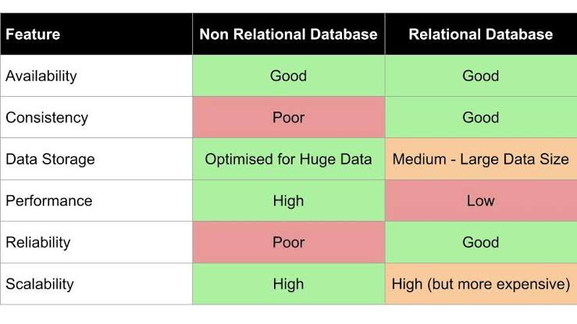
Features of Relational & Non-Relational Data Base

Slide 11
Characteristics of Relational & Non-Relational Data Base System
Relational Databases
Structured Data: Data must fit into predefined schemas (tables, columns).
Schema: Rigid structure that defines data types and relationships.
ACID Compliance: Guarantees reliable transactions (Atomicity, Consistency, Isolation, Durability).
Non-Relational Databases
Flexible Schema: No fixed structure; data can be added without a predefined schema.
Varied Data Models: Supports documents, key-value pairs, wide-column stores, and graph databases.
Eventual Consistency: Focus on high availability and scalability, often trading off immediate consistency

Slide 12
In Conclusion Choosing between relational and non-relational databases depends on the specific requirements of your application. If you need strict data integrity and complex queries, relational databases are preferable. However, if your application demands flexibility, scalability, and can tolerate eventual consistency, non-relational databases may be the better option.

Slide 13
IBM: Relational vs Non-Relational Databases
MongoDB: What is a NoSQL Database?
W3Schools: W3Schools SQL Tutorial
TutorialsPoint: NoSQL Databases
https://www.oracle.com/ng/database/what-is-database/
existek.com
graffersid.com
towardsdatascience.com
References:

